Slide 1
Machin’s Formula for Computing Pi
V. Frederick Rickey
West Point
HPM-Americas, Washington, DC, 13 March 2010

Slide 2
To celebrate Pi Day, the clues to this sudoku are the first 18 digits of π = 3.14159265358979323...
http://brainfreezepuzzles.com/main/piday2010.html

Slide 3
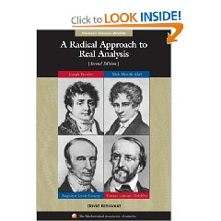
Prove Machin's identity:

Slide 4
Fortunately, a hint:

Slide 6
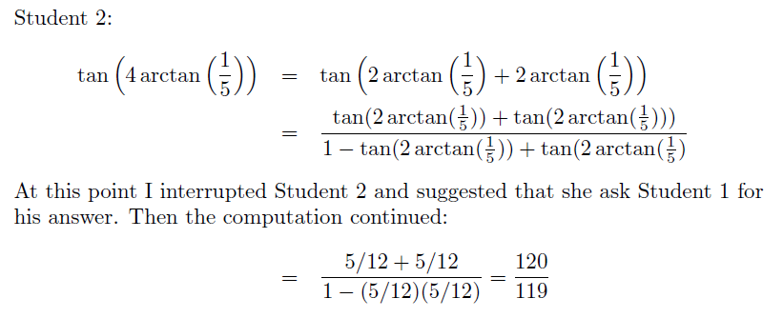

Slide 8
Do you understand the details?
Is the proof correct?
Not so fast. You know tan (π/4) =1, so all you proved is 1 = 1.

Slide 9
This is correct, inelegant, uninspiring mathematics.
This is not the way to do mathematics.
You must explain where the 1/5 comes from.
Time for some historical research.

Slide 10
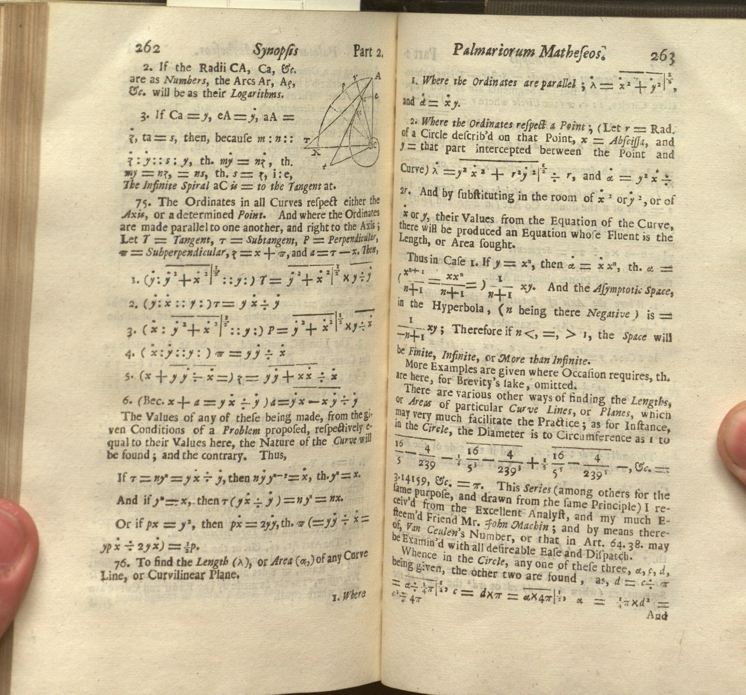
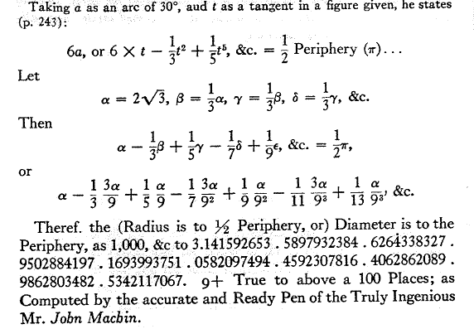
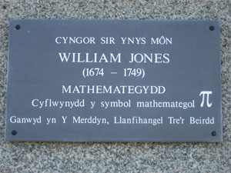
D. E. Smith, Source Book (1929)

Slide 11
Use Gregory’s Series for the arctangent and Machin’s formula to get:

Slide 12
Off to the Library
William Jones
by William Hogarth, 1740
Notes:
National Portrait Gallery

Slide 13
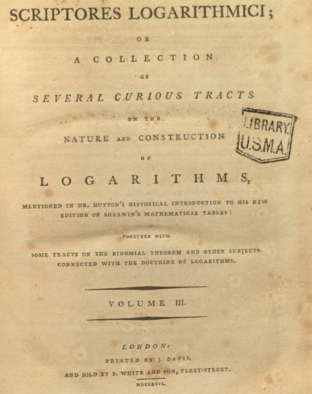
Francis Maseres 1731 –1824

Slide 14
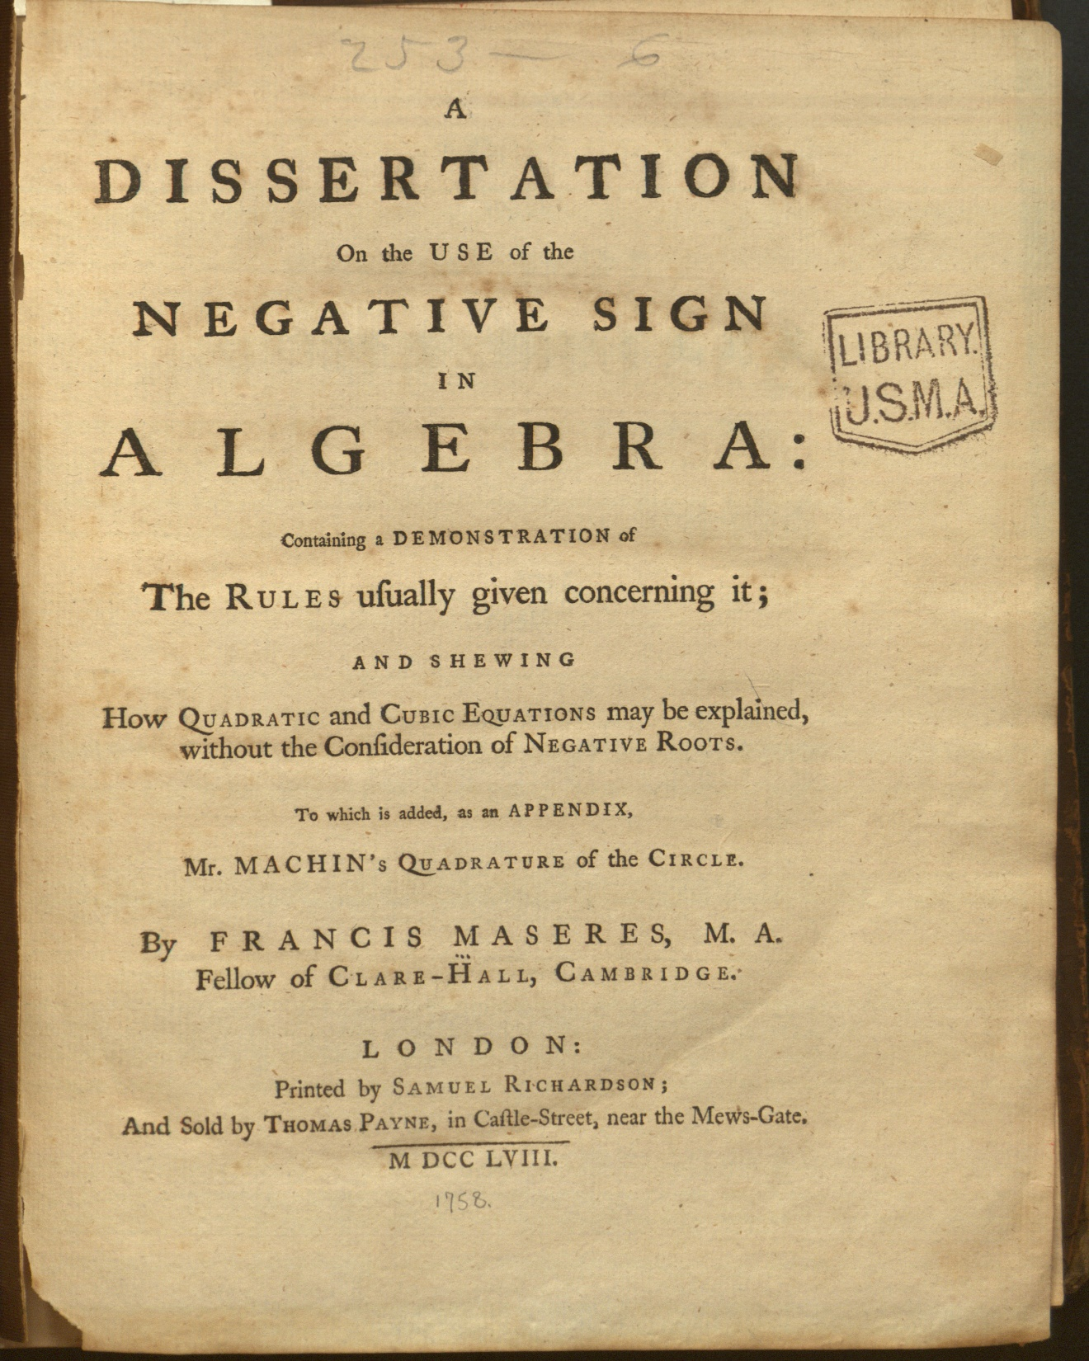
Machin’s Formula and Proof first published here.
But 1/5 still not explained.

Slide 15
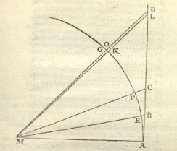
Charles Hutton: A Treatise on Mensuration (1770)
The Idea
Want a small arc whose tangent is easy to compute
Tan 45º = 1
Easy to find tan 2x, given tan x.
Repeat till tan 2^{n}x ≈ 1.
Now Experiment
Try tan x = 1/5
Then tan 4x = 120/119 ≈ 1.

Slide 16
Now let’s compute
Plan:
Compute 1/5^{n} for odd n.
Compute positive terms by dividing by the appropriate odd number, then add.
Compute negative terms: divide, then add.
Subtract sum of negatives from sum of positives and multiply by 16.
Repeat for the other series.

Slide 17
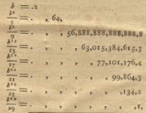

Slide 18
For the second series, divide repeatedly by 239² = 57121:

Slide 19
Thus π ≈ 3.141,592,653,589,238,426

Slide 20
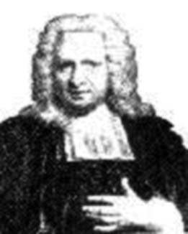
Was Machin an Idiot Savant?
Tutored Brook Taylor before Cambridge.
Taylor announced “Taylor’s Theorem”
to Machin.
His work on π attracted Newton’s attention.
Elected FRS in 1710.
Edited the Commercium epistolicum with Halley, Jones, 1712.
Became Gresham Professor of Astronomy in 1713.
A proposition of Machin on nodes of the moon is included in the third edition of Newton’s Principia
John Conduitt wrote: “Sr. I. told me that Machin understood his Principia better than anyone.”

