Slide 1
Jared Mansfield: Ohio's First Mathematician
V. Frederick Rickey, West Point
Gary Kennedy, Ohio State / Mansfield
MAA Ohio Section, April 3, 2009, BG

Slide 2
Jared Mansfield, 1759-1830
New Haven 1759-1795
Philadelphia 1795-1801
West Point 1802-1803
Ohio 1803-1811
New Haven 1811-1813
West Point 1814-1830

Slide 3
New Haven
Born 1759
Probably learned navigation from his sea captain father
Entered Yale at age 14
Expelled for stealing library books and other discreditable escapades
Ran the Hopkins Grammar School
Whipped Henry Baldwin for playing a trick him in school

Slide 4
Philadelphia
In 1795 he was “situated among the Quakers whose children I instruct in Latin & Greek”
His salary was £ 300. The next highest paid teacher received £ 68.
Did he meet Jefferson? Franklin?

Slide 5
Essays, Mathematical and Physical
On the use of the negative sign in algebra
Goniometrical properties
Nautical astronomy
Orbicular motion
Investigation of the loci
Fluxionary analysis
Theory of gunnery
Theory of the Moon

Slide 6
George Baron
The zeroeth professor of mathematics at West Point, 1801
Founded
The Mathematical Correspondent,
the first mathematical periodical in the US, 1804
Notes:
Used Hutton’s Course in Mathematics
Used Hutton’s Course in Mathematics
Used Hutton’s Course in Mathematics. I took this out because I will do Hutton momentarily.

Slide 7
Professor Baron furnished me with Dr. Hutton's Mathematics, and gave me a specimen of his mode of teaching at the blackboard at the academy.
Joseph G. Swift, first graduate of West Point.
First use in US?
Notes:
Add title page of Adrian’s edition of Hutton

Slide 8
Baron founded this journal, the first in the US devoted to a single subject
His caustic personality led to its demise

Slide 9
Negative Feedback from Baron
Mr. Emerson wrote this problem [of nothing] in the English Language, but has lately been translated into nonsense, by Jared Mansfield of Connecticut, and published in a wonderful work, which this translator called Mathematical Essays. The infinitely small nothings of Connecticut, are infinitely great absurdities, in the regions of science and common sense.
Notes:
P, 65.

Slide 10
More Negative feedback:
“Jared Mansfield, in his Mathematical Essays, has attempted to define a negative quantity. Jared’s discourse on this subject reminds me of a Connecticut carle, who said that the moon was exactly the size of a Johnny-cake”
Is this jealously because Mansfield succeeded Baron at West Point?

Slide 11
Positive Feedback
Abraham Baldwin send a copy of Mansfield’s Essays to Jefferson
Jefferson appointed Mansfield to teach mathematics at the U. S. Military Academy

Slide 12
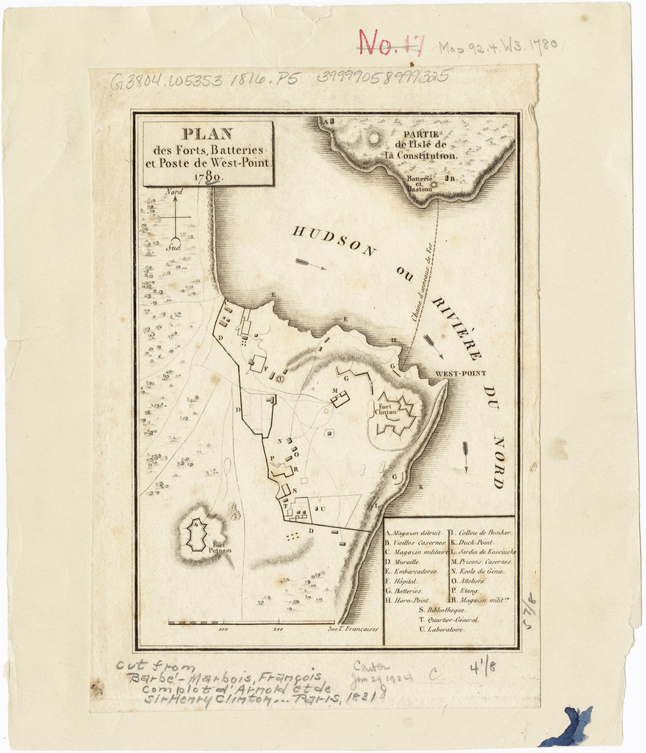
West Point
1780

Slide 13
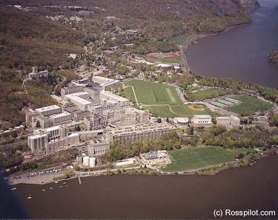
Notes:
http://www.us-coin-values-advisor.com/images/West%20Point-Aerial-view.jpg

Slide 14
Jared Mansfield at West Point
Taught mathematics 1802-1803
Used Hutton
USMA’s first Professor of Natural and Experimental Philosophy, 1812-1828.
Portrait by Thomas Sully, 1783-1872

Slide 15
Publications of Mansfield
A calculation of the orbit of the comet [on 1810]
On the figure of the Earth (1810)
On the duplication of the cube, and the trisection of an angle (1810)
Manual of instructions to regulate field operations of deputy surveyors (1804, 1815)
On vanishing fractions (1818)

Slide 16
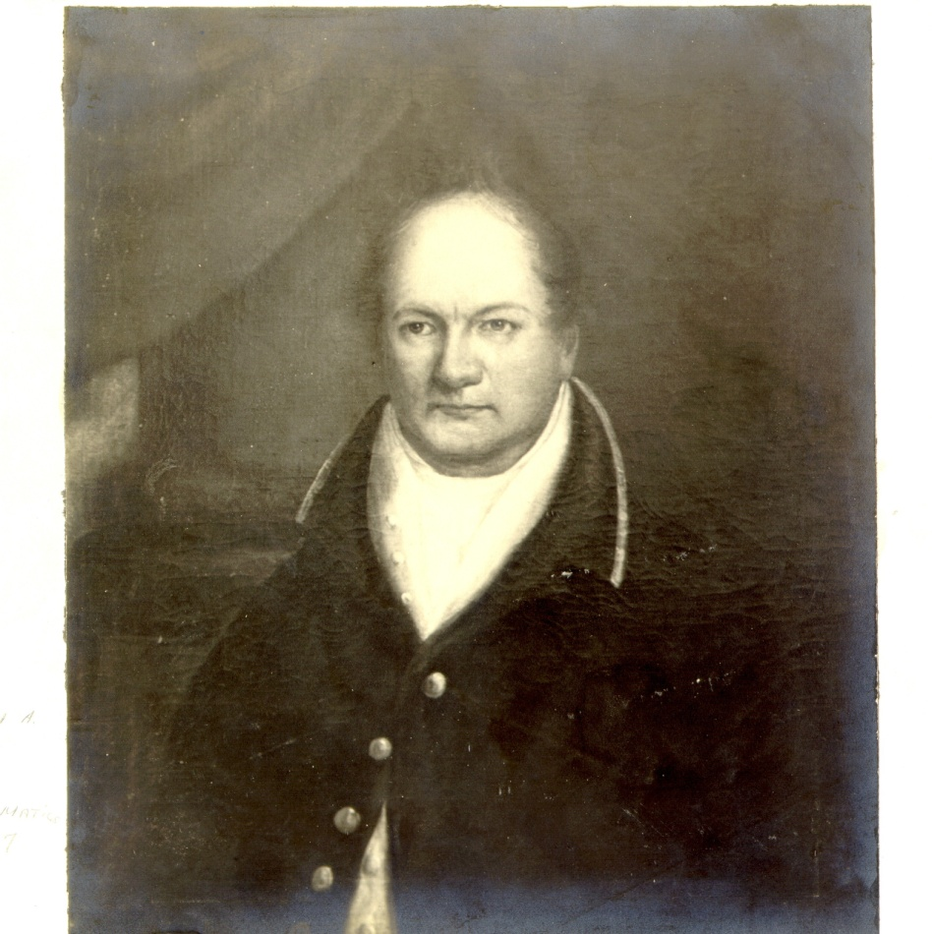
Jefferson hired a second mathematician at West Point, William Barron.
But why? There were only a dozen or so cadets.
Had he already planned to appoint Mansfield surveyor general in 1803?
At WP 1802-1807

Slide 17
Some Famous Surveyors
George Washington
Mason and Dixon
Andrew Ellicott
Thomas Hutchins
Rufus Putnam
Jared Mansfield

Slide 18
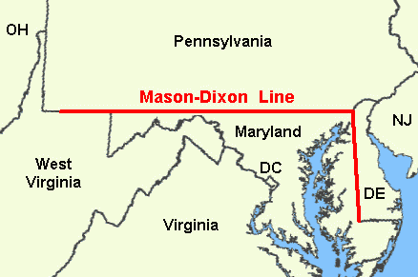
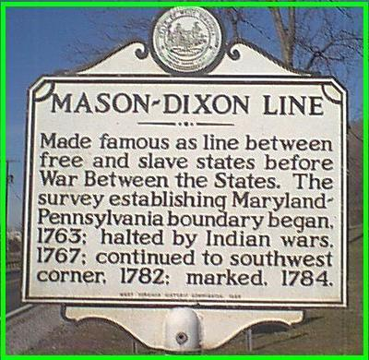

Slide 19
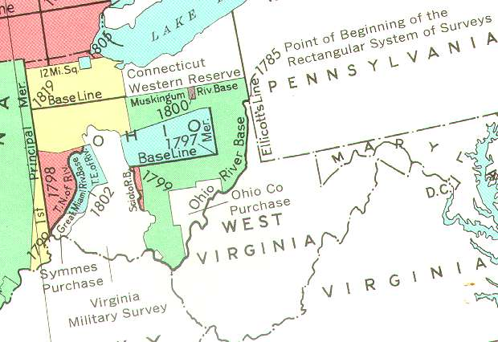
Notes:
http://www.toledowar.com/ohiosurveys.jpg

Slide 20
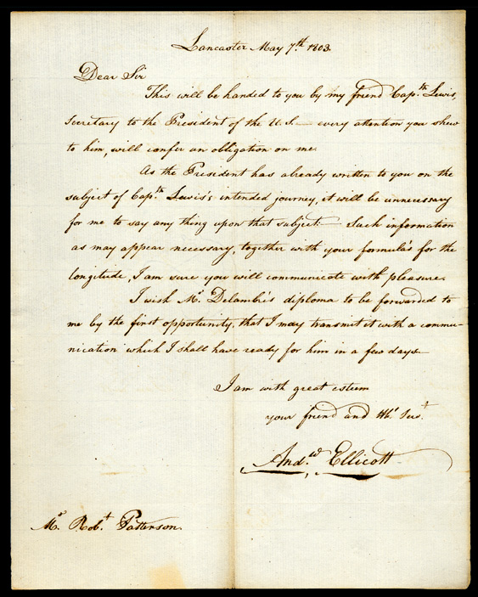
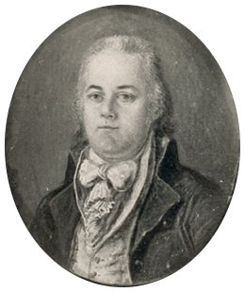
Ellicott tutored Meriwether Lewis in surveying and navigation
Notes:
1799 image.

Slide 21
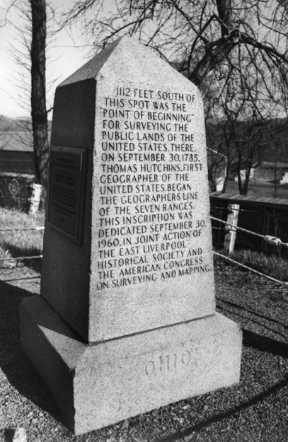
1112 feet south of this spot was the "Point of Beginning" for surveying the public lands of the United States. There on September 30, 1785, Thomas Hutchins, first geographer of the United States began the Geographers' Line of the Seven Ranges.
East Liverpool, Ohio
Notes:
http://images.ulib.csuohio.edu/cdm4/item_viewer.php?CISOROOT=/general&CISOPTR=2759&CISOBOX=1&REC=2

Slide 22
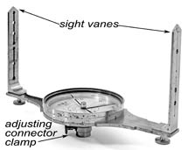
Thomas Hutchins (1730 – 1789)
Appointed “Geographer of the United States” in 1781.
Directed the survey of “The Seven Ranges”
Used
A sextant to measure latitude
A circumferentor to measure angles
A chain to measure distances

Slide 23
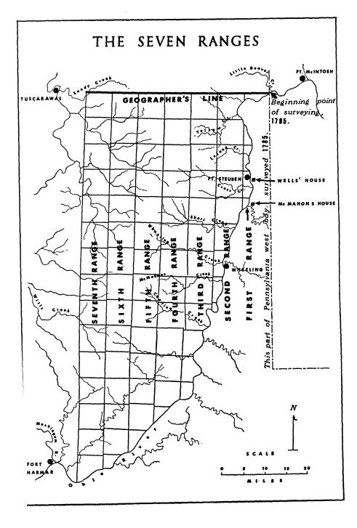
Problems:
Starting Position mislocated by half a mile.
Did not follow the curve of the parallel of latitude
Ended 1500 feet south of the start
Ignored poor closure
Lacked regular operating procedures.
Notes:
Pattison, “The Survrey of the Seven Ranges,”

Slide 24
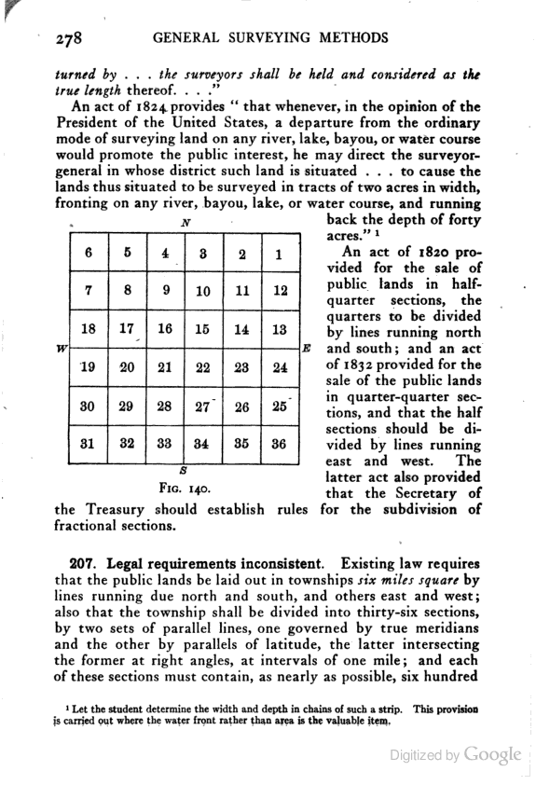
Townships are six miles square
Sections are one mile square
Boustrophedonic order

Slide 25
To Run a Meridian Line
Instruments were needed:
A 3 ft reflecting telescope
A 30 inch portable transit
An astronomical pendulum clock
Ordered from Troughton in London, 1803
Did not arrive until 1806

Slide 26
Mansfield’s Contributions
1804 instructions to field operators
Surveyed the “first prime meridian”, the Ohio-Indiana border
Ran an East-West base line at 41 degrees.
Did extremely careful work, based on astronomical observations
Found a way of correcting for the curvature of the earth

Slide 27
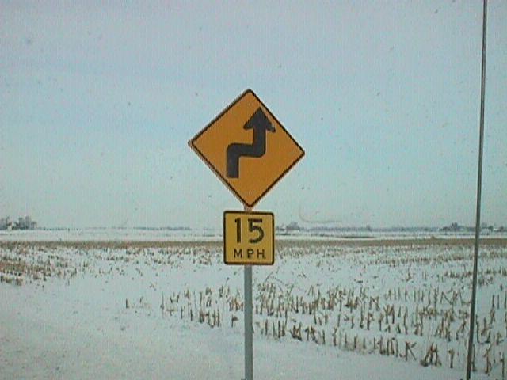
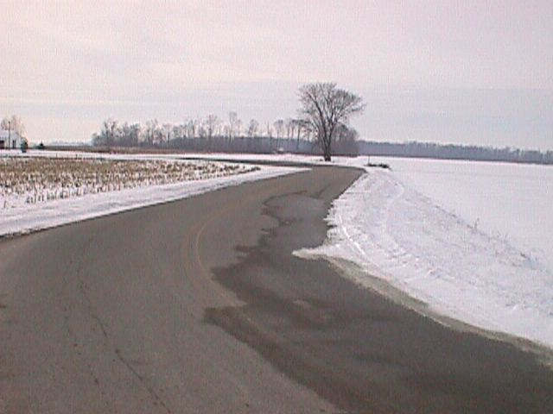
Notes:
http://www.toledowar.com/

Slide 28
What if the polygon does not close?
Robert Paterson, U. Penn, posed this question in The Analyst in 1808 with a $10 prize.
Nathaniel Bowditch provided a solution.
Editor Robert Adrain provided a long commentary, which included the method of least squares!

Slide 29
Return to West Point
Appointed Professor of Natural and Experimental Philosophy, 1812
Sickness delayed him in 1814
Taught classes in his parlor
Used Enfield’s Institutes of Natural Philosophy, Theoretical and Practical
A strict but kindly teacher

Slide 30
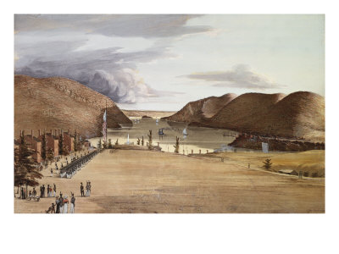
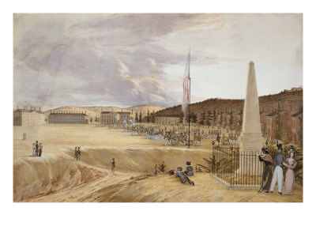
West Point:
The Wood Monument
George Caitlin, 1828

Slide 31
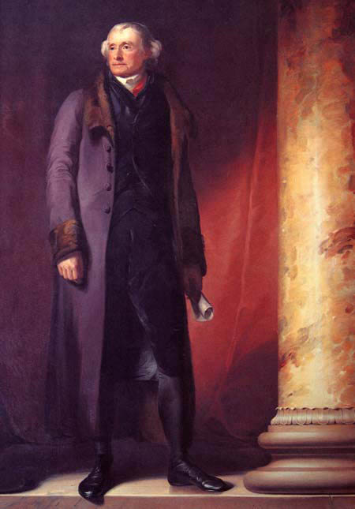
The Professors and Cadets “are anxious for some special & appropriate memorial of your person”
Mansfield to Jefferson, 1821
By Thomas Sully

Slide 32
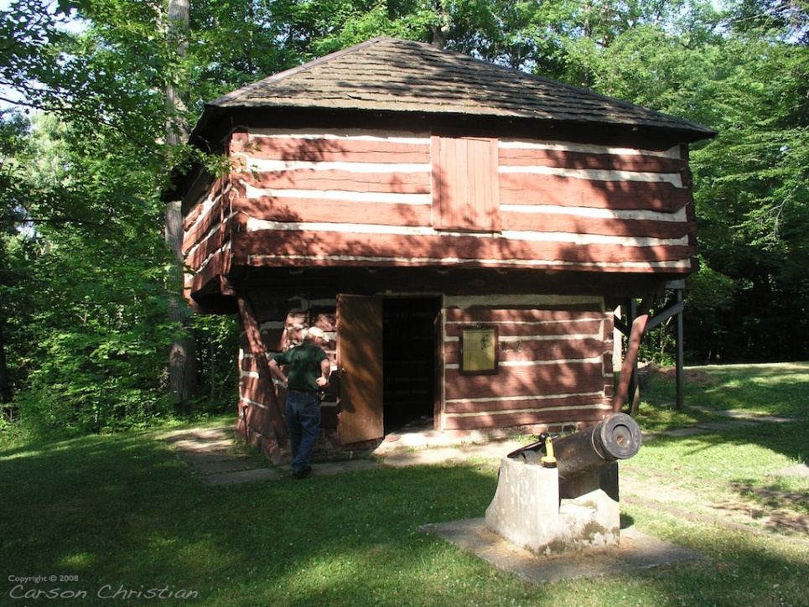
The Mansfield Blockhouse, 1812
Mansfield, Ohio, was founded in 1808 by three surveyors from Mansfield’s team.
He never visited there, but the town was named in his honor.
Notes:
http://www.planexus.com/projects/mansfield/start/01.jpg

Slide 33
Some Relatives
Son Edward was a famous journalist
Daughter Mary Ann married Charles Davies
Nephew Joseph Totten was Chief of Engineers
Richard Mansfield Dudley is a probailist at MIT
Edith Scilla is a historian of science
Alice Carmel is a faithful correspondent
Notes:
I removed the following after the talk as I was challenged on it:
Nephew Joseph was the highest ranking Union officer killed in the Civil War
Gen James McPherson was highest ranking.

Slide 34
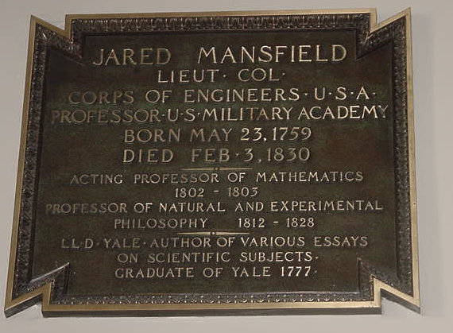

Slide 35
Jared Mansfield , 1759-1830
Early distinguished for intellectual power, industry and self-denial. His attainments in classical learning, Mathematics, Astronomy and Philosophy were pre-eminent. As a public officer, able and friendly. As a Professor and instructor of youth, loved and venerated, of singular integrity. “His word was a bond.” In the discharge of his duties, conscientious. Few have better deserved the character of a wise and just man.

