Slide 1
History can make your class sparkle
V. Frederick Rickey
West Point
Ohio NExT, 3 March 2009

Slide 2
One day a monk leaves at sunrise to climb a mountain. He walks at a leisurely pace, sometimes stopping to enjoy the view, even retracing his path to look again at a pretty flower. He arrives at the summit at sundown, spends the night meditating, and starts home down the same path the next day at sunrise, arriving home at sunset.
Was there a time of day when he was exactly at the same point on the trail on the two days?

Slide 3
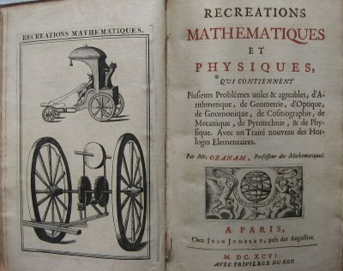
On this date − April 3 −
in 1717 Jacques Ozanam died. He is noted for his book on mathematical recreations.
He was wont to say that it was the business of the Sorbonne doctors to discuss, of the pope to decide, and of a mathematician to go straight to heaven in a perpendicular line.
Notes:
[DSB 10, 264].

Slide 4
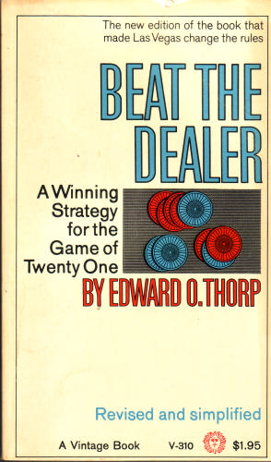
Also on this date − April 3 −
in 1964, The New York Times reported that the casinos in Las Vegas have changed their rules in blackjack so as to defeat the winning strategy devised by Edward O. Thorp.

Slide 5
For more mathematical dates see:
http://www.dean.usma.edu/departments/math/people/rickey/hm/calendar/
Soon to be updated (pester me).

Slide 6
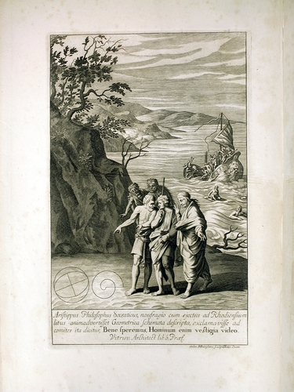
Archimedes,
The Socratic philosopher Aristippus, who was shipwrecked on the shores of Rhodes, saw geometric diagrams, and exclaimed to his friends:
Fear not, for I see the vestiges of men.
-- Vitruvius

Slide 7
Students Naturally Ask:
Where do problems come from?
Who posed them?
Why?

Slide 8
There Is
No
Creationism
In
Mathematics

Slide 9
The Historical Approach
Is Harder
For Student and Teacher
But: The student
  Learns more
  Understands more
  Sees how mathematics is done
And: The teacher
  Can not do this without history

Slide 10
History
Aids
Understanding

Slide 11
Ways to Use History in Class
To introduce a new topic
History of specific concepts
History of notation
Etymology of terms
Biography --- Identify every name mentioned
Quotations by famous mathematicians
Anecdotes
Problems from old textbooks
As a way to discuss advanced and modern topics
Historical errors
Today in the history of mathematics.

Slide 12
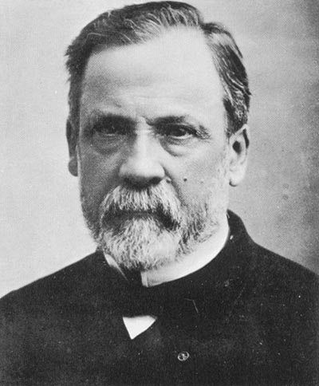
Louis Pasteur (1822-1905)
Let me tell you the secret that has led me to my goal. My strength lies solely in my tenacity
French chemist and bacteriologist who proposed the “germ” theory and developed food sterilization, including “pasteurization.”
Notes:
http://en.wikipedia.org/wiki/Louis_Pasteur

Slide 13
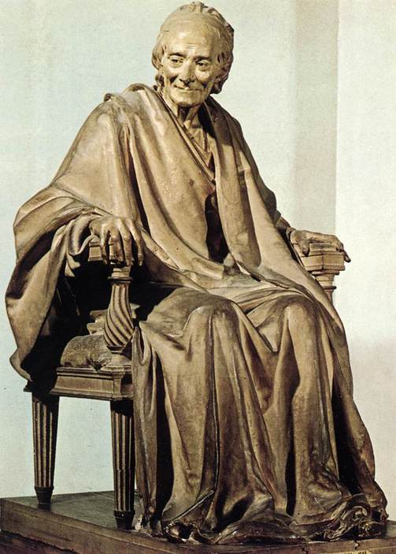
The best way to be become boring is to say everything.
Voltaire (1694-1778) was a French philosopher, poet, novelist, and playwright. He attacked Tyranny, bigotry, and religious fanaticism while working towards political reform. His “Candide” (1759) satirises Leibniz.

Slide 14
Seminar Rules Apply
Ask any Question at any Time

Slide 15
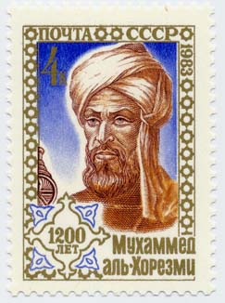
Abu Ja'far Muhammad ibn Mūsā al-Khwārizmī
Lived c. 780 to c. 850
Stamp issued September 6, 1983 in the Soviet Union to commemorate the 1200th anniversary of al-Khwārizmī's birth.

Slide 16
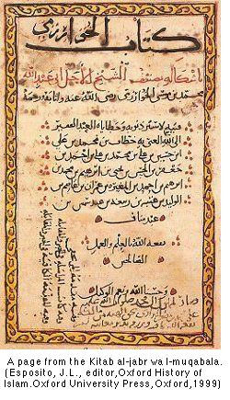
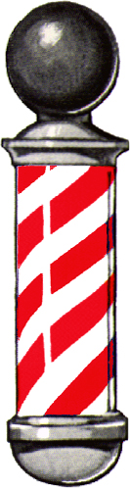
Kitab al-jabr wa l-muqabala
The book of restoration and balancing
“what is easiest and most useful in arithmetic”
Origin of our word algebra
Notes:
http://www.cmima.csic.es/mirror/mattom/science+society/lectures/illustrations/lecture16/alkhwarizmi.html
J. L. Esposito, Oxford History of Islam, 1999

Slide 17
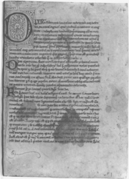
Latin translation, beginning with "Dixit algorizmi"
His name is the origin of our word “algorithm”

Slide 18
Six Types of Quadratics
Squares equal to roots
  x² = 5x
Squares equal to numbers
  x² = 9
Roots equal to numbers
  4x = 20
Squares and roots equal to numbers
  x² + 10x = 39
Squares and numbers equal to roots
  x² + 21 = 10x
Roots and numbers equal to squares
  3x + 4 = x²
Notes:
http://members.aol.com/bbyars1/algebra.html
This is messed up. Should not have the square roots there. I fixed it. Agrees with Karpinski translation.

Slide 19
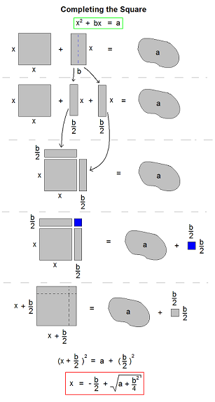
Notes:
http://en.wikipedia.org/wiki/Completing_the_square

Slide 20
Abstraction makes mathematics easier !
The introduction of zero
The coefficients include negative reals
a x² + b x + c = 0

Slide 21
Although “Euler” is pronounced “Oil-er”, it does not follow that
“Euclid” is pronounced
“Oi-clid.”

Slide 22
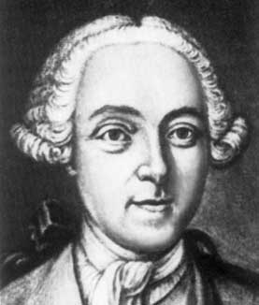
Euler about 1737, age 30
Painting by J. Brucker
1737 mezzotint by Sokolov
Black below and above right eye
Fluid around eye is infected
“Eye will shrink and become a raisin”
Ask your ophthalmologist
Thanks to Florence Fasanelli

Slide 23
Euler creates trig functions in 1739

Slide 24
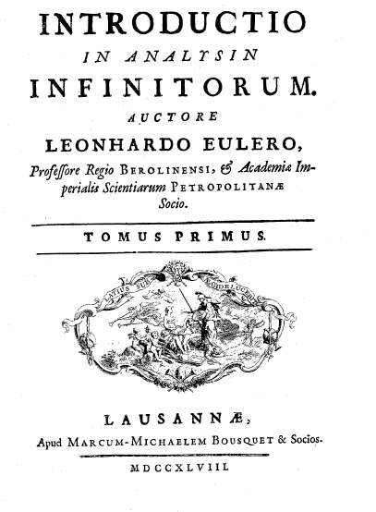
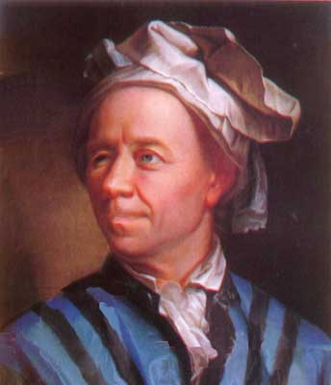

Slide 25
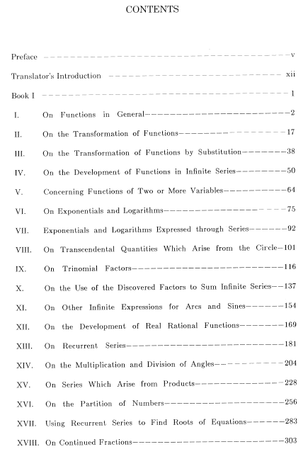

Slide 26
Often I have considered the fact that most of the difficulties which block the progress of students trying to learn analysis stem from this: that although they understand little of ordinary algebra, still they attempt this more subtle art.
From the preface of the Introductio

Slide 27
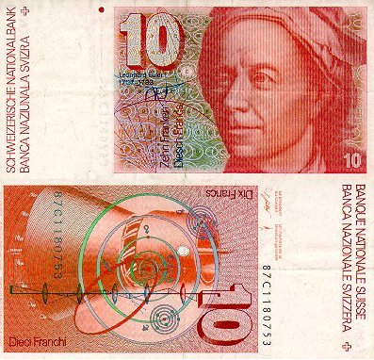
Chapter 1: Functions
A change of Ontology:
Study functions
not curves

Slide 28
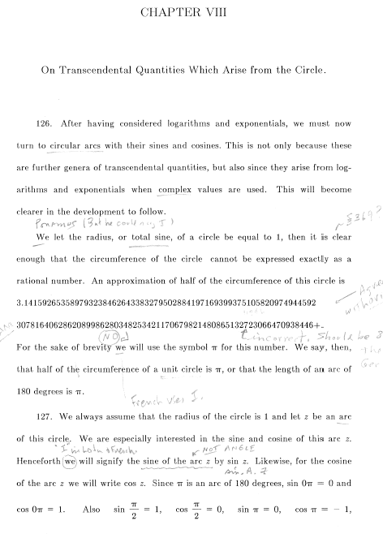

VIII. Trig Functions

Slide 29
He showed a new algorithm which he found for circular quantities, for which its introduction provided for an entire revolution in the science of calculations, and after having found the utility in the calculus of sine, for which he is truly the author . . .
Eulogy by Nicolas Fuss, 1783
Notes:
, he provides for in the second part the general theory of curves with their divisions and sub-divisions and in a supplement the theory of solids and their surfaces while showing how their measurement leads to the equations with three variables and he ends finally this important work by developing the idea of curves with double curvature which provides for the consideration of the intersection of curved lined surfaces.
Read at the Imperial Academy of Sciences of Saint Petersburg 23 October
http://www-groups.dcs.st-and.ac.uk/~history/Extras/Euler_Fuss_Eulogy.html

Slide 30
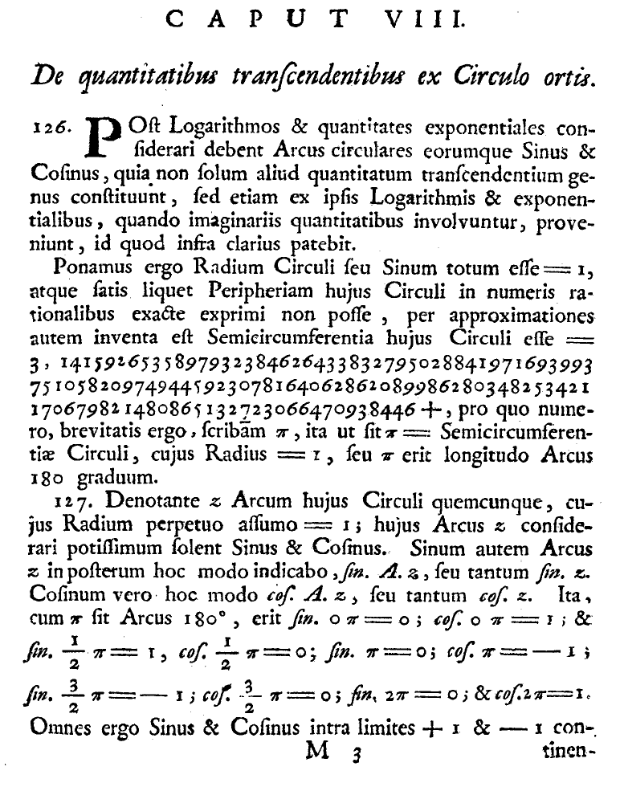
Sinus totus = 1
π is “clearly” irrational
Value of π from de Lagny
Note error in 113th decimal place
“scribam π”
W. W. Rouse Ball discovered (1894) the use of π in W^{m} Jones 1706.
Arcs not angles
Notation: sin. A. z

Slide 31
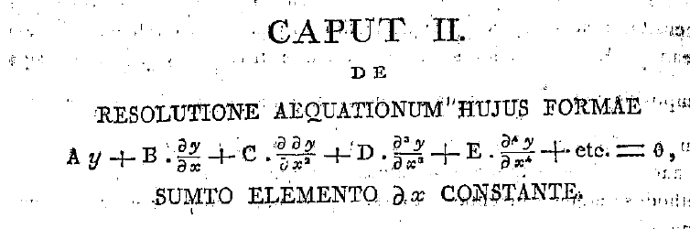
Institutionum calculi integralis, 1769
E366

Slide 32
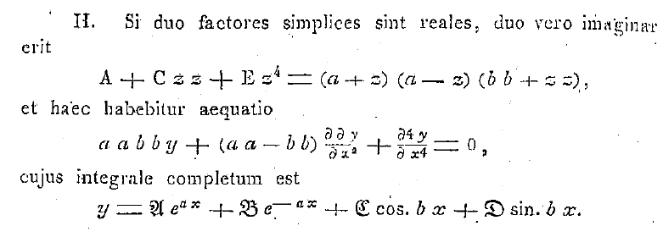

Slide 33

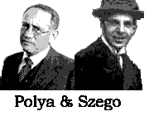
George Pólya (1887-1985)
Gábor Szegő (1895-1985)
An idea which can be used only once is a trick. If you can use it more than once it is a method.

Slide 34
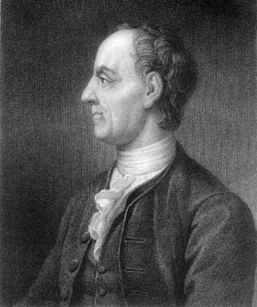
Read Euler, read Euler, he is our teacher in everything.
Laplace
as quoted by Libri, 1846
Notes:
> G. Libri wrote in Journal des Savants, Janvier 1846, p. 51:
>
> ...ces paroles me/morables que nous avons entendues de sa propre
> bouche: _Lisez Euler, lisez Euler, c'est notre mai^tre a\ tous_.
>

Slide 35
"One can invent mathematics without knowing much of its history. One can use mathematics without knowing much, if any, of its history. But one cannot have a mature appreciation of mathematics without a substantial knowledge of its history."
-- Abe Shenitzer

Slide 36
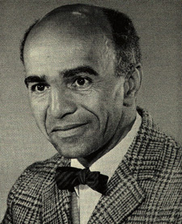
David Blackwell
The next year I really fell in love with mathematics. I had a course in elementary analysis. We used Hardy’s Pure Mathematics as a text. That’s the first time I knew that serious mathematics was for me. It became clear that it was not simply a few things that I liked. The whole subject was beautiful.

Slide 37
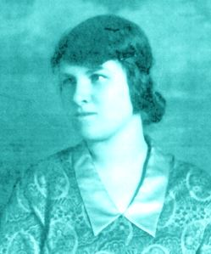
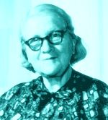
Rózsa Péter (1905-1977)
One of the founders of recursion theory
No other field can offer, to such an extent as mathematics, the joy of discovery, which is perhaps the greatest human joy.
Notes:
http://www.sdsc.edu/ScienceWomen/peter.html

Slide 38
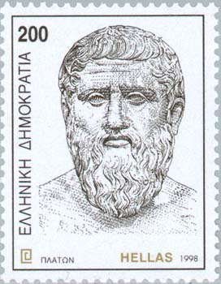
Plato (4227-347 BC)
If women are expected to do the same work as men, we must teach them the same things.

Slide 39
“The instruction of children should aim gradually to combine knowing and doing. Among all sciences mathematics seems to be the only one of a kind to satisfy this aim most completely.”
-- Immanuel Kant

Slide 40
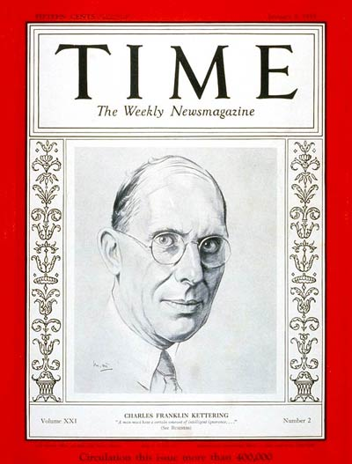
There is a great difference between knowing and understanding: you can know a lot about something and not really understand it.
Charles Kettering (1876-1958) was a U.S. engineer and inventor. He invented the electric cash register (1911) and the electric starter (1912).
Notes:
1912 was the date electric starters were installed on cadilacs

Slide 41
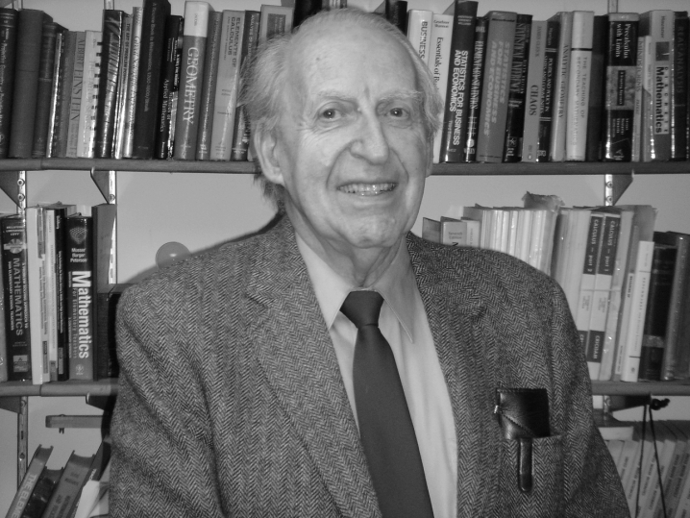
Henry O. Pollak
Applied mathematics is mathematics for which I happen to know an application. This, I think, includes almost everything in mathematics.

Slide 42
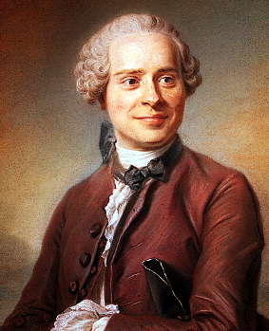
Jean le Rond d'Alembert (1717-1783)
Algebra is generous,
she often gives more than is asked of her.

Slide 43
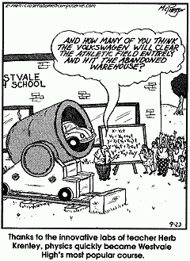
Cartoons provide an opportunity to speak of many things:
Projectile motion
History of Ballistics
Ethics

Slide 44
Bernhard Bolzano (1781-1848)
Son of an art dealer who founded an orphanage.
Studied philosophy, physics and mathematics at Prague.
Ordained a Catholic Priest in 1804.

Slide 45
Appointed to the new chair of philosophy of religion at the University of Prague
An unsuitable position given his unorthodox religious and political ideas.
Dismissed in 1819 and placed under house arrest.

Slide 46
Purely analytic proof of the theorem that between any two values which give results of opposite sign there lies at least one real root of the equation

Slide 48
Abraham Gotthelf Kästner (1719-1800)
Proved statements which were commonly regarded as evident in order to make clear the assumptions on which they are based.
Influenced both Bolzano and Gauss.

Slide 49
Early work on infinite sets!
Defined continuity.
Constructed a nowhere differentiable function.

Slide 50
Assumptions?

Slide 51
Is there a direction I can point such that the temperature at the boundary of the State is the same in that direction and in the opposite direction?

Slide 52
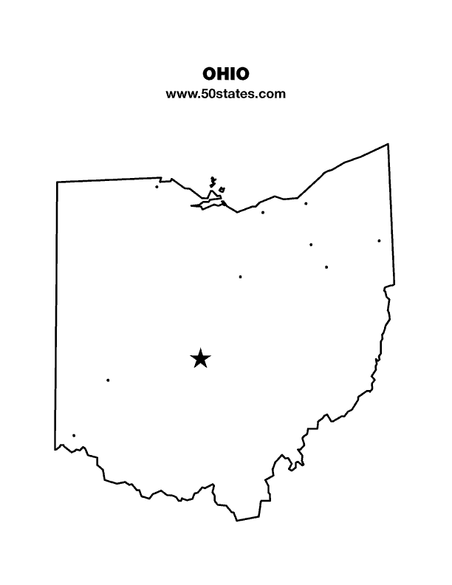
T(Θ) = Temperature at border of state when you are in Columbus and looking in direction Θ.
Consider
  F(Θ) = T (Θ) – T(Θ + π)
F(0) and F(π) have opposite signs.

Slide 53
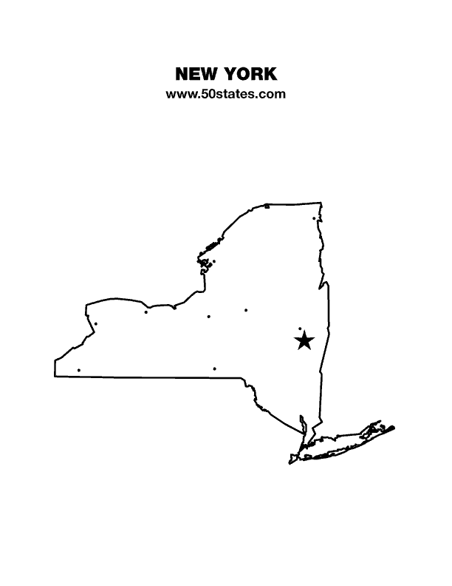
Consider
  F(Θ) = T (Θ) – T(Θ + π)
Does it matter whether you are in Albany or West Point or Selden?

Slide 54
Our Hero !
Bernhard Bolzano proved the Intermediate Value Theorem in 1817.

Slide 55
We are carriers of the Mathematical Culture
We would be derelict as teachers if we did not pass it on in all its richness.

Slide 56
One can invent mathematics without knowing much of its history. One can use mathematics without knowing much, if any, of its history. But one cannot have a mature appreciation of mathematics without a substantial knowledge of its history.
Abe Shenitzer quoted in "Thinking the Unthinkable: The Story of Complex Numbers (with a Moral)," by Israel Kleiner, Mathematics Teacher, Oct. 1988.

Slide 59
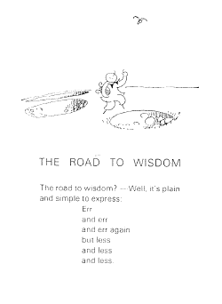

Slide 60
There are many ways to use history in the classroom. If you report what happened on this day in the history of mathematics, your students will love it, but won't let you skip a day. Quotations are always great fun. Both of these allow you to mention a wide range of people and ideas that the students are otherwise unlikely to encounter. The bulk of the presentation will be a discussion of several tested classroom examples at various levels: completing the square, trigonometry from Archimedes to Euler, Bolzano and the intermediate value theorem, and designing a clepsydra with calculus. There will be time for lots of questions, at the dinner, and at the meeting, so bring yours along.

Slide 61
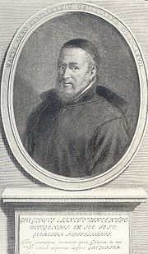

Slide 62
“One night early in my tenure [at ONR] I was sitting at my desk, working late, when I was joined by the military officer whom the staff of the research division identified as the spiritual father of the Office of Naval Research, Capt. Robert Conrad. He was a great man and a great leader, and his energy and enthusiasm set the tone of ONR. He sat down, and said to me, after a little chit-chat: “Mina, if you want to include pure mathematics in your program, I'll support you in your decision.” This was a great day for all of us, for it meant an end to the constant worry as to whether the Navy would see the needs of mathematics as we saw them.”
Mina Rees, 1977

Slide 63
http://www.dean.usma.edu/departments/math/people/Boucher/Today%20in%20Math%20History/Today%20in%20Math%20History.html

Slide 64
“I have so little aptitude in writing out my [mathematical] demonstrations that I have been content to have discovered the truth, and to know the means of proving it when I shall have reason to do so.”
– Pierre de Fermat

Slide 65
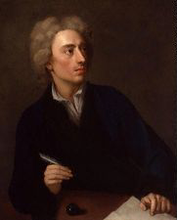
Ah! Why, ye Gods, should two and two make four?
Alexander Pope
(1688-1744)

