Slide 1
The Fundamental Theorem of Calculus

Slide 2
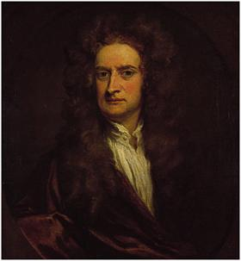
Isaac Newton 1642 - 1727
1702 portrait by Kneller
The original is in the National Portrait Gallery in London

Slide 3
On 16 July 1730 in Mathematics
Alexander Pope (1688-1744) published the famous lines which were intended as an epitaph for Newton:
Nature and Nature's Laws lay hid in night: God said, Let Newton be!, and all was light.
They were published in the Grub-Street Journal.
Notes:
[{\sl Scripta Mathematica}, 3(1935), 283.

Slide 4
Took Descartes’s Geometry in hand, tho he had been told it would be very difficult, read some ten pages in it, then stopt, began again, went a little farther than the first time, stopt again, went back again to the beginning, read on til by degrees he made himself master of the whole, to that degree that he understood Descartes’s Geometry better than he had done Euclid.

Slide 5
Descartes’s Geometry, 1637, 1659

Slide 6
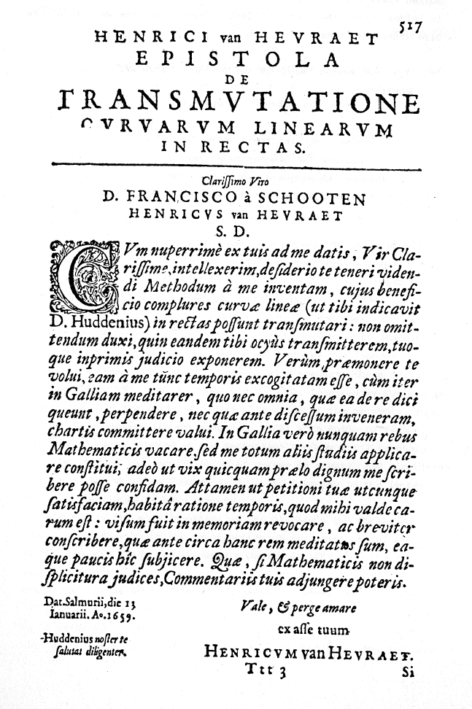
van Heurat on Arc Length, 1661

Slide 7
van Heuraet’s rectification, 1659

Slide 9
The Fundamental Theorem of Calculus
A Method whereby to square such crooked lines as may be squared.

Slide 10
For Newton
Mathematical quantities are described by Continuous Motion.
E.g., Curves are generated by moving points
In Modern Terms: All variables are functions of time

Slide 11
Newton said that quantities flow, and so called them fluents.
How fast they flow – or flex – he called fluxions.
Par abuse de langu,
d/dt ( fluent ) = fluxion

Slide 13
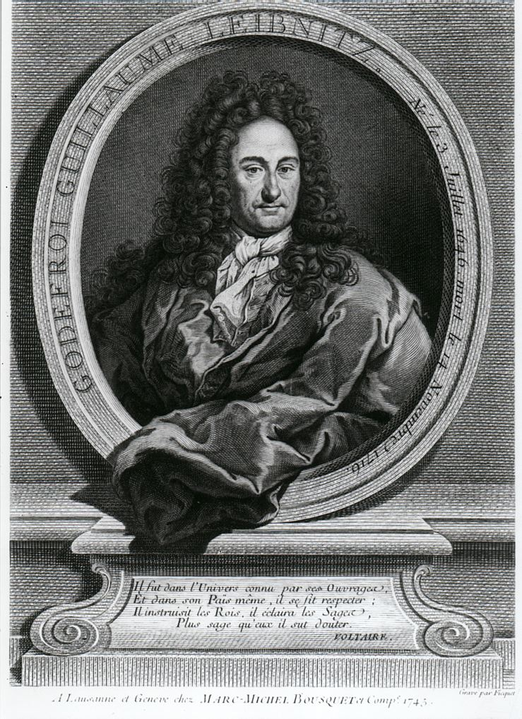
Gottfried Wilhelm von Leibniz (1646 – 1716) and the product rule

Slide 14
The Product Rule: 11 November 1675
Leibniz introduces the dx notation and asks “Is dx . dy = d(x . y)?”
He lets x = cz + d and y = z² + bz and computes dx.dy = c (2z +b).
“But you get the same thing if you work out d(x.y) in a straightforward manner.”
Later that day: Whoops!

Slide 15
The Product Rule: 21 November 1675
dx . y = d (x . y) – x . dy.
“Now this is a really noteworthy theorem.”*
It took Leibniz 10 days to correct his error, and, my dear students, if you don’t master this in 10 days, you will not do well on the next exam.
From the zeroeth Putnam Exam (1933): When is dx . dy = d(x . y)?”
* The Early Mathematical Manuscripts of Leibniz, ed. by J. M. Child (1920/2005), p. 107

Slide 16
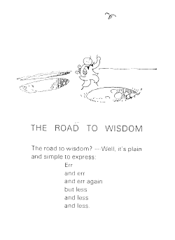

Slide 17
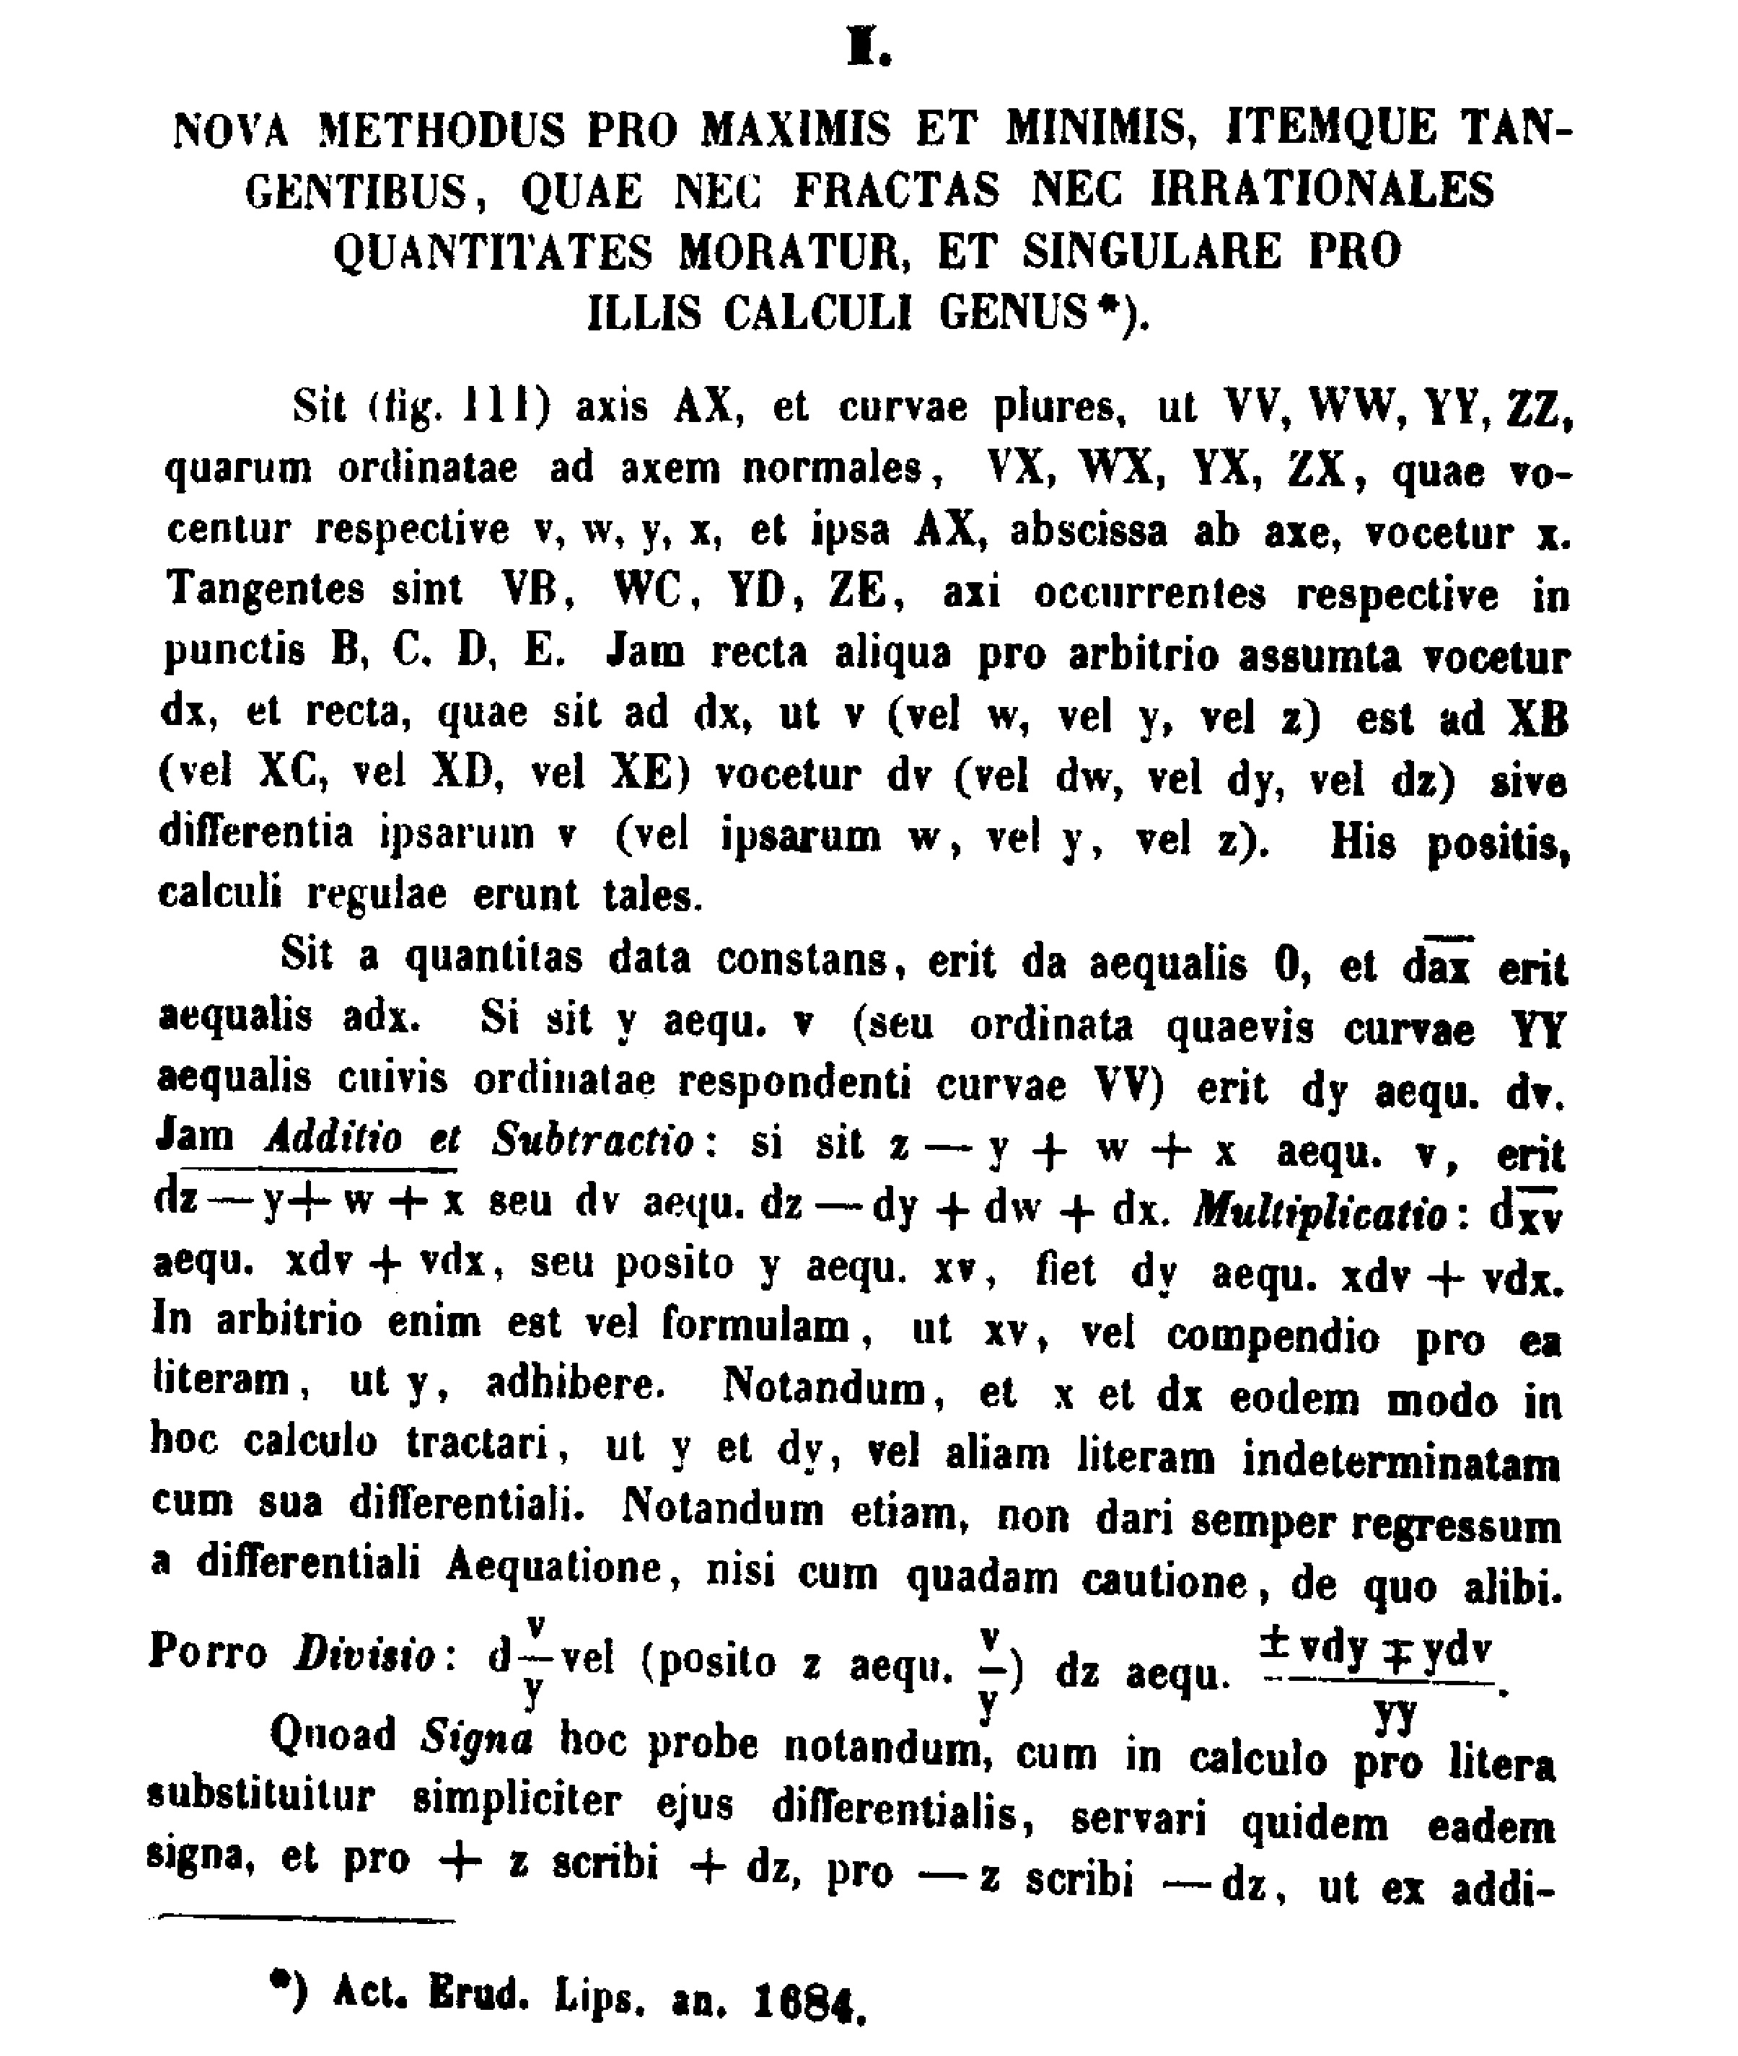

Slide 18
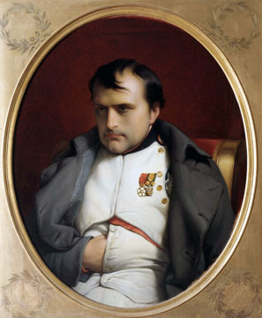
Bonaparte rightly said that many of the decisions faced by the commander-in-chief resemble mathematical problems worthy of the gifts of a Newton or an Euler.
Carl von Clausewitz, On War, 1832
Notes:
http://www.carolinaarts.com/606scstatemuseum1.html

