Slide 1
Eric Temple Bell's Men of Mathematics: From Influential to Infamous V. Frederick Rickey fred-rickey@usma.edu West Point, NY 10996

Slide 2
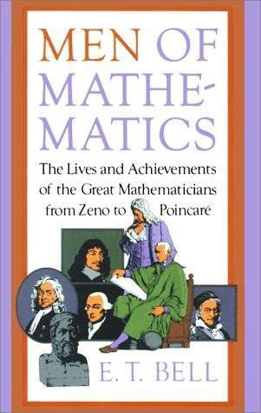
Eric Temple Bell, 1883 - 1960
Published 1937
Continuously in print
Libraries have 4300 copies
Received the gold medal of the Commonwealth Club of CA
Title chosen by the publisher
29 portraits in early editions

Slide 3
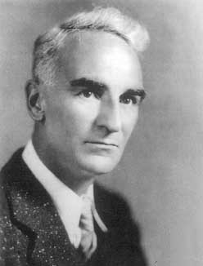
Bell’s Education
AB, honors, Stanford, 1904
2 years
AM, Washington, 1908
1 year
Ph.D., Columbia, 1912
1 year

Slide 4
Teaching Career
HS in San Francisco, 1904 – 1907
Yreka High School, 1909 – 1911
University of Washington, 1912 – 1926
California Institute of Technology, 1926 – 1953

Slide 5
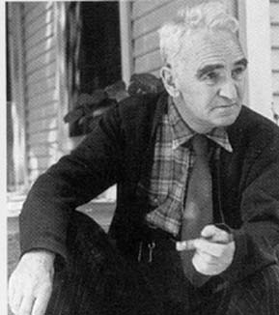
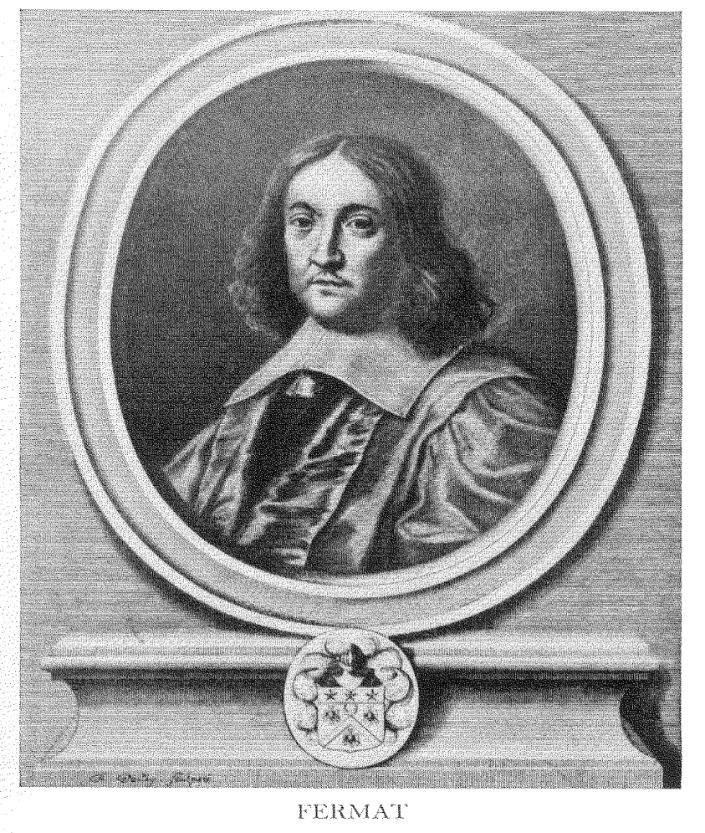
When Bell retired in 1953, he was given a copy of the Arithmetica of Diophantus (1670) signed by many men and women.

Slide 6
Bell’s Research Mathematics
Arithmetical functions ― 35 papers
Arithmetical paraphrases ― 80
Bell numbers and polynomials ― 30
Diophantine analysis ― 30
Miscellaneous ― 40
215 publications.
88 papers listed in MathSciNet
Only 1% of mathematicians have published this much

Slide 7
Honors
Bôcher Prize, 1926
National Academy of Sciences
AMS Colloquium lectures, 1927
President of the MAA, 1931 – 1933
VP AMS
VP AAAS

Slide 8
11 popularizations
Debunking Science, 1930
The Queen of the Sciences, 1931
Numerology, 1933
The Search for Truth, 1934
The Handmaiden of the sciences (1937)
Men of Mathematics, 1937
Man and His Lifebelts, 1938
The Development of Mathematics, 1945
The Magic of Numbers, 1946
Mathematics: Queen and Servant of Science, 1951
The Last Problem, 1961

Slide 9
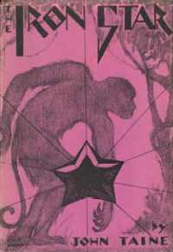
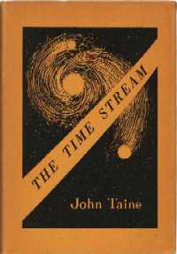
17 Science Fiction Books by John Taine
The Purple Sapphire (1924)
The Gold Tooth (1927)
Quayle's Invention (1927)
Green Fire (1928)
The Greatest Adventure (1929)
The Iron Star (1930)
The Time Stream (1931)
Seeds of Life (1931)
Before the Dawn (1934)
The Time Stream (1946)
The Forbidden Garden (1947)
The Cosmic Geoids (1949)
The Crystal Horde (1952)
G.O.G. 666 (1954)

Slide 10
Chapters in Men of Mathematics
Zeno, Eudoxus, Archimedes
Descartes
Fermat
Pascal
Newton
Leibniz
The Bernoullis
Euler
Lagrange
Laplace
Monge, Fourier
Poncelet
Gauss
Cauchy
Lobatchewsky
Abel
Jacobi
Hamilton
Galois
Sylvester, Cayley
Weierstrass, Sonja Kowalewski
Boole
Hermite
Kronecker
Riemann
Kummer, Dedekind
Poincaré
Cantor
Bell's style is addictive;
he makes every personality come to life

Slide 11
Bell’s Sources: Mostly a Mystery
Jahrbuch über die Fortschritte der Mathematik
Biblioteca Mathematica
Dupuy on Galois (cf. Tony Rothman)
Weierstrass / Kowalewski correspondence
Occasional references in the chapters, e.g., Bliss
HM courses from R. E. Moritz and D. E. Smith

Slide 12
How was Men of Mathematics Received?
What did the reviewers say?

Slide 13
Reviewed by George Sarton, 1938
The longest chapter by far (52p.), and one of the best, is properly devoted to Gauss. It is the best account available in English (within the non-technical limitations of the book) and I will expect my Harvard and Radcliffe students to read it carefully.
The sketch of Gauss is based on Sartorius (1856).

Slide 14
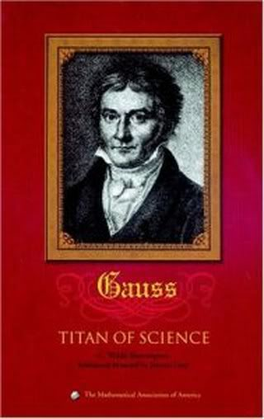
Reviewed by G. Waldo Dunnington, 1937
Dr. Bell is a seasoned, skilful writer with a fluent style; he writes with a realistic, curt, potent wit and stark, frank humor which does not stop short of vigorous, rollicking slang.

Slide 15
The algebraic numbers are spotted over the plane like stars against a black sky; the dense blackness is the firmament of the transcendentals.
Notes:
Bell, p. 569, in the chapter on Cantor. He is talking about the non-denumerability of the transcendentals and the countability of the algebraic numbers.

Slide 16
The majority of the mathematical members of the Bernoulli family . . . did not deliberately choose mathematics as a profession but drifted into it in spite of themselves as a dipsomaniac returns to alcohol.
The Bernoullis took their mathematics in deadly earnest. Some of their letters about mathematics bristle with strong language that is usually reserved for horse thieves.
Notes:
p. 131, 134.

Slide 17
It was inevitable after the work of Cavalieri, Fermat, Wallis, Barrow and others that the calculus should presently get itself organized as an autonomous discipline. Like a crystal being dropped into a saturated solution at a critical point.
Mezzotint after a painting
Of J. Vanderbank, 1725

Slide 18
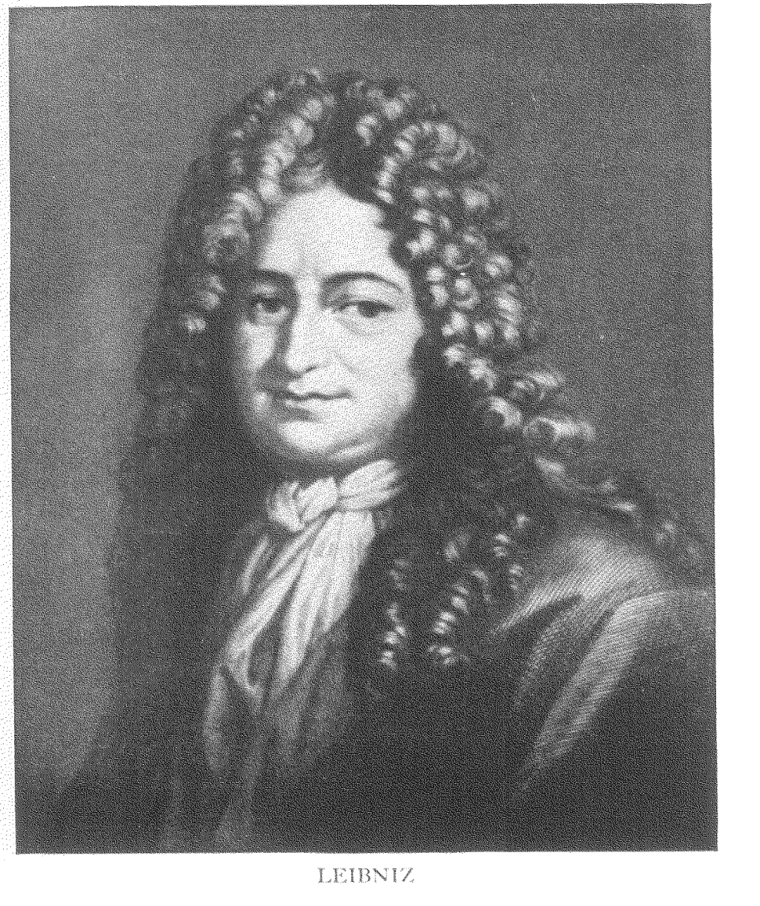
Leibniz was forever disentangling the genealogies of the semi-royal bastards whose descendants paid his generous wages, and proving with his unexcelled knowledge of the law their legitimate claims to duchies into which their careless ancestors had neglected to fornicate them.

Slide 19
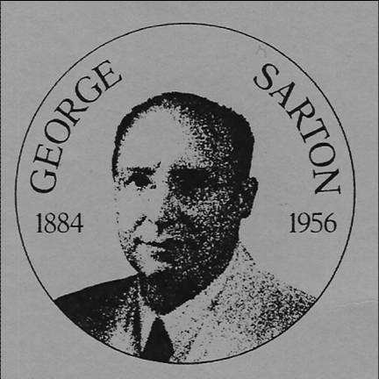
Review by George Sarton, 1938
The most valuable parts [of the book] are . . . the mathematical remarks, drawn from his own rich experience.

Slide 20
Gauss discovered Quadratic Reciprocity
As this is quite simply stated we shall describe it.
There is a beautiful “reciprocity “ between the pair of congruences
x² ≡ q (mod p) and x² ≡ p (mod q),
where, . . .
Gauss turned it over and over in his mind for many years, seeking to find its taproot, until he had given six distinct proofs.
Notes:
Men of Math, p. 225ff.

Slide 21
Reviewed by Lao G. Simons, 1938
The reader of Men of Mathematics lays down the book after a first reading with a feeling of profound satisfaction that here is a fascinating set of short stories.
This book may be read with appreciation by the intelligent layman

Slide 22
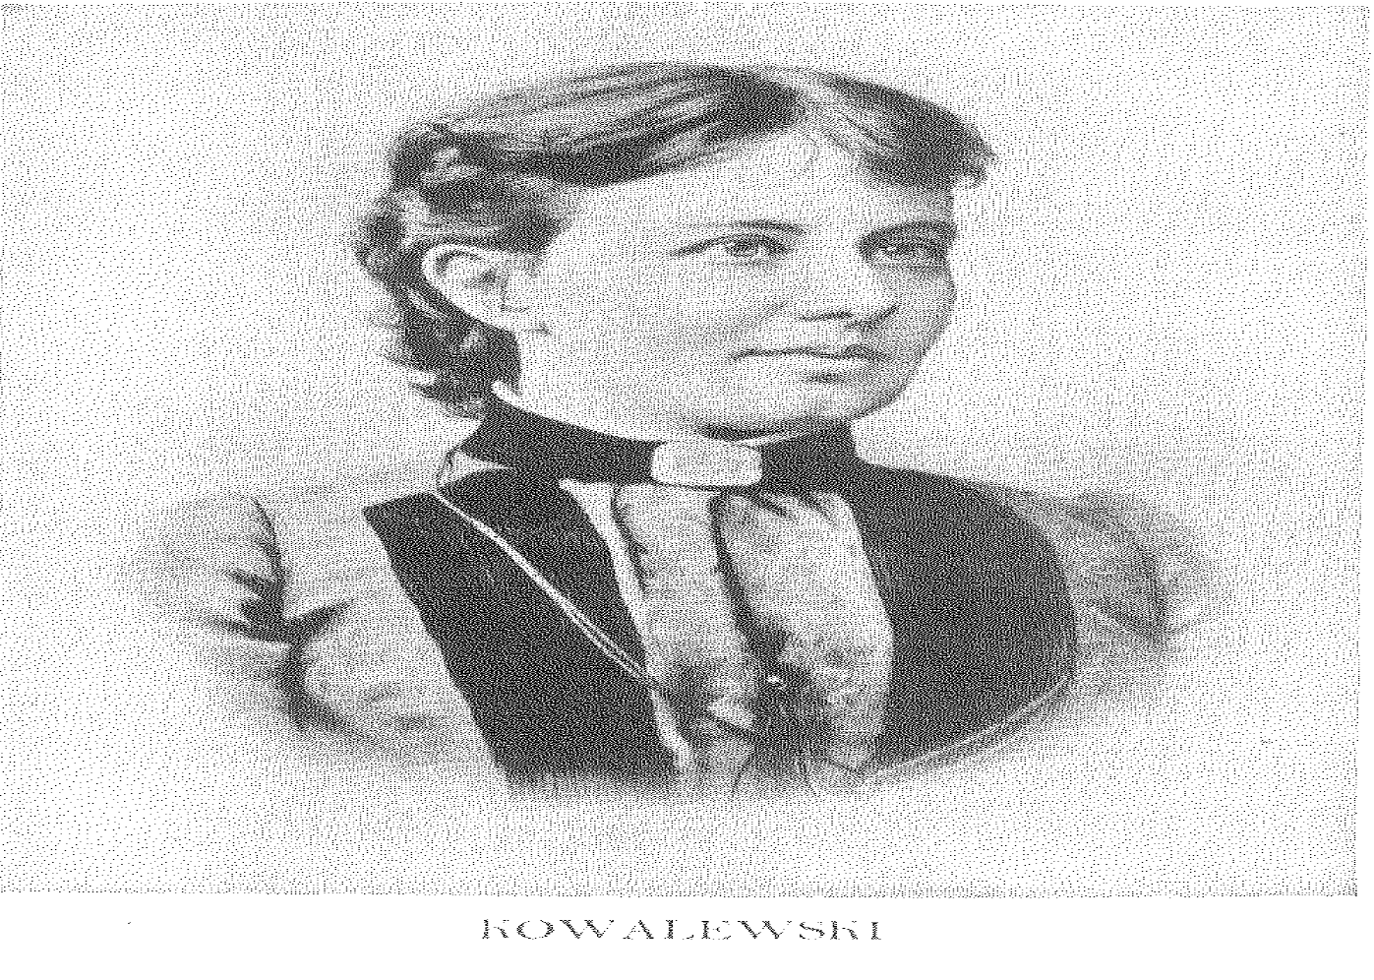
"Sonja's sex had got the better of her ambitions and she had been living happily with her husband.“
― Bell
Spends undue amount of time discussing Kowalewski's sexual attributes and their effect on her mathematical colleagues and teachers, and little explaining her contributions to mathematics.
― An Amazon reviewer

Slide 23
No Reviewer Called Bell a Sexist
The first citation of the word “sexist” in the OED was by Fulton J. Sheen in 1949
“In the Forties, I was a sexist like almost everyone else.’’ Benjamin Spock, 1989

Slide 24
Question
People complain about the errors, exaggerations, and prejudices in Men of Mathematics . . .
. . . but have they read it?

Slide 25
The Bad . . .
Sometimes Bell ignored his sources
He simply made up some stories
Today his prejudices show

Slide 26
. . . And the Good
Bell had read widely
He mostly gave the right feel
The book is captivating
The book is inspiring

Slide 27
Give this Book to Young People
They will enjoy reading it
They can learn from the books faults
There is no better book on this theme
And now some examples of the book’s impact

Slide 28
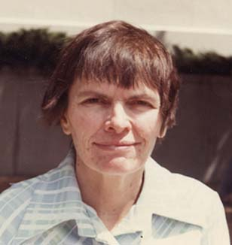
Julia Robinson, 1990.
The only idea of real mathematics that I had came from Men of Mathematics. In it I got my first glimpse of mathematician per se. I cannot overemphasize the importance of such books for students like myself . . . I learned many interesting things from Bell’s book . . . I was especially excited by some theorems of number theory.
Notes:
Albers et al., More Mathematical People, p. 269.

Slide 29
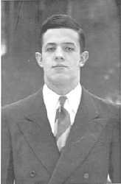
John Nash
By the time I was a student in high school I was reading the classic "Men of Mathematics" by E. T. Bell and I remember succeeding in proving the classic Fermat theorem about an integer multiplied by itself p times where p is a prime.
Notes:
http://nobelprize.org/nobel_prizes/economics/laureates/1994/nash-autobio.html
John Nash was the winner of the 1994 Nobel Prize in Economics for his development of the Nash Equillibrium he discovered for Non-cooperative games. There is a famous biographical movie about his life, which, apparently like the lives of the mathematicians in this book, is quite eccentric. The movie is "A Beautiful Mind".

Slide 30
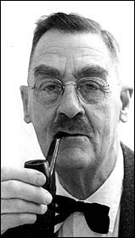
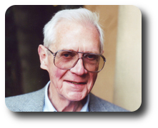
My family has produced several mathematicians, but I am not one of them. However, this book is extremely interesting ― just do as I did and skim right over the math.
Florence Ogg Smith (in an Amazon review)

Slide 31
The Last Problem
This expository book was almost finished when Bell died on December 20, 1960
D. H. Lehmer wrote the last chapter
Shortly it inspired a ten-year-old named Andrew Wiles

Slide 32
Read Bell!
Read Bell!
He is the
inspiration of us all!

